Slide 1



CULTURE SPOT 1
The United Kingdom

Slide 2
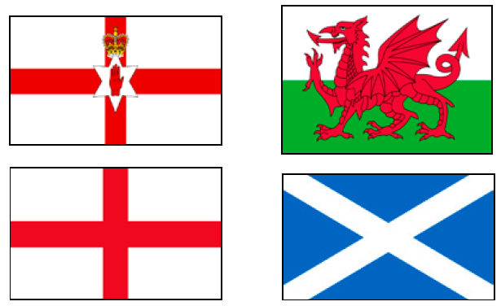
Look at the flags. Whose flags are these?
Match the flags with the correct country.
England Northern Ireland Scotland Wales
Northern Ireland
Wales
England
Scotland

Slide 3

Do you know anything about these countries?
What are they parts of?
Do you know what is the difference between the United Kingdom and Great Britain?
Do you know anyone who is from England/Wales/Scotland/Northern Ireland?

Slide 4
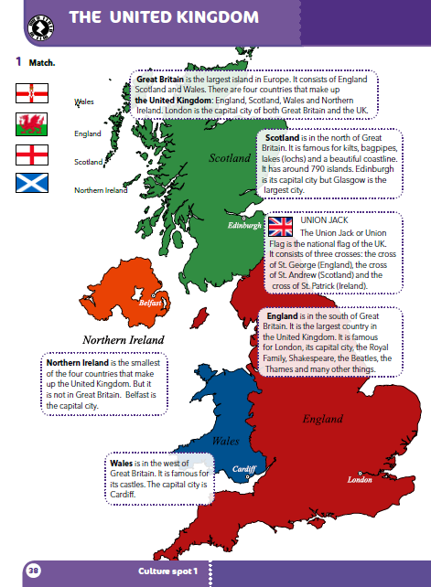
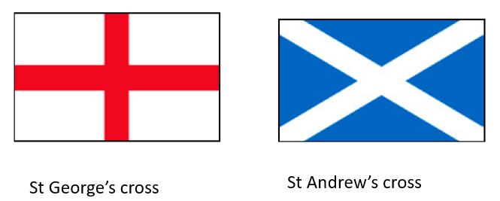

Where on this page can you find information on which flag belongs to which country?
Do you know what St George’s and St Andrew’s crosses look like? Search the web and find out.
Which of these crosses can you see when you travel by train?
St Andrew’s cross.
St George’s cross
St Andrew’s cross

Slide 5
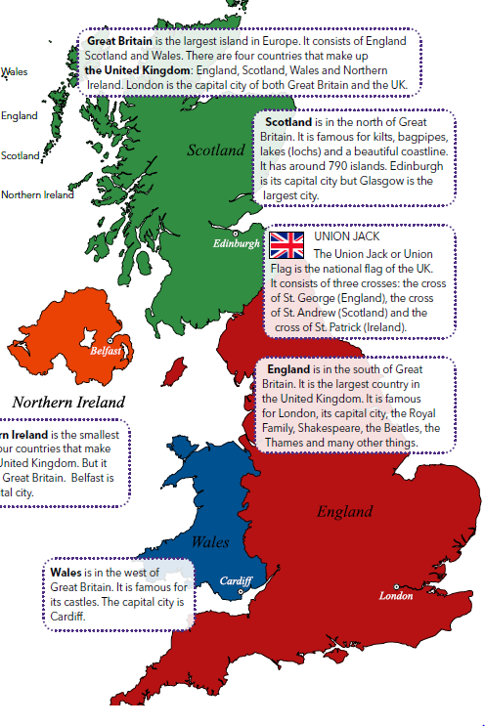
Look at the map.
What is the capital of:
England
Wales
Scotland
Northern Ireland
→ London
→ Cardiff
→ Edinburgh
→ Belfast

Slide 6
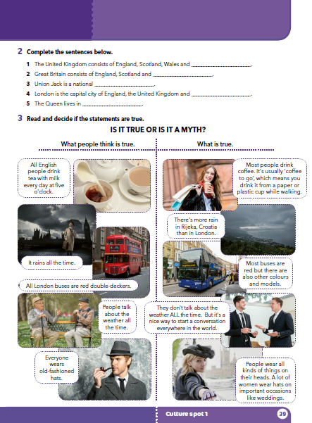
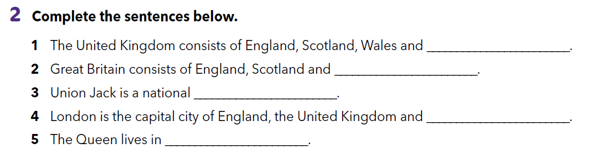
Read the texts (page 38) and complete the sentences.
Northern Ireland
Wales
flag
Great Britain
England

Slide 7
Find out more about the United Kingdom. Play the following games.
https://wordwall.net/play/552/977/634
https://wordwall.net/play/552/971/824
Think up one quiz question based on the texts about the UK.

Slide 8
Choose one of the cities (Belfast, Edinburgh, Cardiff or London) and prepare a short presentation about it. Include the following information:
Where is it?
What is its country famous for?
How many people live there?
What is it famous for? (4 people or places)

Slide 9
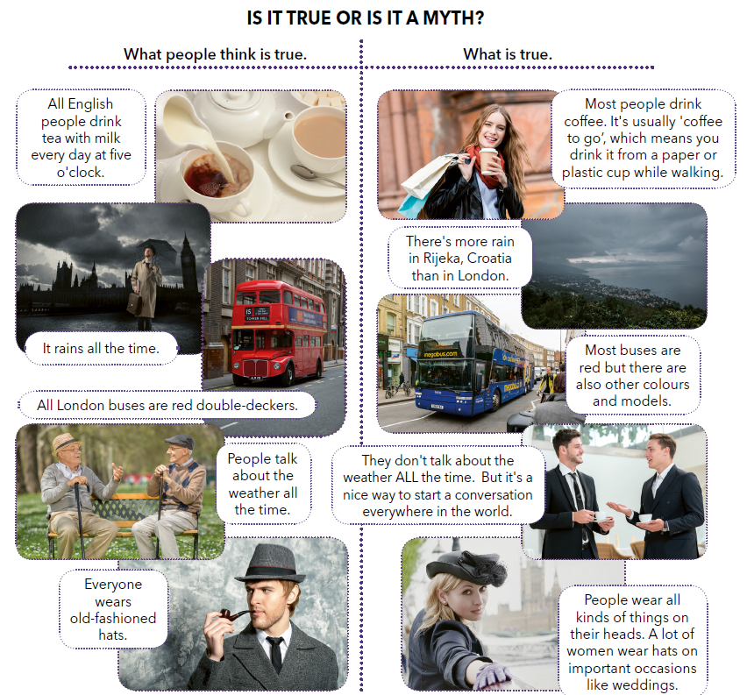
Mark the texts in the first column (‘”What people think is true.”) with letters A-E.
A
Think! What is a myth?
A
Look at the pictures and say which myths they represent?
B
What surprised you the most?
B
Match the myths and the truth.
C
C
D
D
E
E

Slide 10
Prepare a short presentation about myths about Croatia or your town/region. Write what people think is true (the myth) and what is true. Add appropriate photos or drawing to your presentation.

Slide 11

LEARN MORE.
https://www.e-sfera.hr/dodatni-digitalni-sadrzaji/16303c02-2133-414a-b8e2-b41a0b26d3da/
Polite behaviour in the UK
Read the text about polite behaviour in the UK.

